Slide 1
QMail: A Hybrid QKD/KEM Quantum-Resistant Email Client
CSE7101- Capstone Project
Review-1
Batch Number: CSE_42
Under the Supervision of,
Dr. Joseph Michael Jerard V
Professor
School of Computer Science and Engineering
Presidency University
Roll Number | Student Name
20221CSE0407 | S Pranav Roy
20221CSE0422 | Achal K A
20221CSE0185 | Satvik Varma
Name of the Program: Computer Science and Engineering
Name of the HoD: Dr Asif Mohammed
Name of the Program Project Coordinator: Dr. Jayavadivel Ravi
Name of the School Project Coordinators: Dr. Sampath A K , Dr. Geetha A

Slide 2
Problem Statement Number: PCS_178
Organization: Indian Space Research Organisation (ISRO)
Category (Hardware / Software / Both) : Software
Problem Description:-
Email communication is a vital component of modern business and personal interactions, yet conventional encryption methods remain susceptible to threats such as eavesdropping, man-in-the-middle attacks, and data breaches, especially in the emerging post-quantum era. Quantum Key Distribution (QKD) offers a higher level of security by enabling the secure exchange of encryption keys over a quantum channel, providing unconditional or enhanced protection against interception. This project proposes the development of QuMail, an email client similar to Microsoft Outlook that integrates QKD services with standard email protocols to secure communications while maintaining compatibility with widely used providers such as Gmail and Yahoo Mail. QuMail will interface with a Key Manager (KM) to retrieve quantum keys via APIs, connect with email servers through SMTP/IMAP protocols, and offer a graphical user interface for user interaction. In the intended use scenario, users with access to QKD-derived symmetric keys, pre-stored in local KMs, can exchange emails and attachments securely over untrusted networks. The system will begin with a key bank of 100 symmetric keys, each 1 KB in size. It will support three security levels: Level 1 – no quantum security, Level 2 – quantum-aided AES encryption using quantum keys as seeds, and Level 3 – quantum-secure encryption using the One-Time Pad. The key challenge is to design a robust and modular mechanism to integrate QKD into existing email infrastructures, ensuring interoperability, scalability, and the ability to upgrade KM services and authentication features as technology evolves.

Slide 3
Problem Statement : Quantum Secure Email Client Application
Email communication is widely used but increasingly vulnerable to advanced cyberattacks like eavesdropping and man-in-the-middle attacks. Traditional encryption methods may become ineffective with the rise of quantum computing. Quantum Key Distribution (QKD) offers a promising solution by enabling the generation of encryption keys with theoretically unbreakable security. However, integrating QKD technology into existing email systems and protocols while ensuring compatibility with popular email services like Gmail and Yahoo poses a significant challenge. The problem is to design and develop a modular, user-friendly email client that incorporates QKD for secure key exchange and supports multiple security levels. This solution should enable secure email transmission over untrusted networks without disrupting existing email workflows or user experience.

Slide 4
Objectives
Develop a desktop email client integrated with Gmail using Google OAuth, supporting three levels of selectable encryption levels [No Encryption, AES-256 with PQC/QKD keys, and One-Time Pad].
Develop a quantum-safe email client that prevents cyber fraud and financial exploitation for individuals, small businesses, and NGOs by securing sensitive financial communications against current and future cyber threats.
Implement a secure Key Manager (KM) to manage device registration, public key distribution, and one-time pad key allocation, ensuring that only authorized devices can decrypt messages.
Ensure quantum-safe end-to-end encryption so that intercepted emails remain unreadable even to future quantum computers (“Harvest Now, Decrypt Later” protection).
Enable seamless user experience where emails are automatically decrypted on the receiver’s registered device without saving plaintext to disk or servers.

Slide 5
Background and related work
Email security has historically relied on classical cryptographic methods such as RSA and ECC, which are vulnerable to quantum attacks like Shor’s algorithm. While post-quantum cryptography (PQC) algorithms such as Kyber and NTRU provide quantum-resistant alternatives, most real-world email systems have yet to adopt them. Existing secure email solutions like ProtonMail, Tutanota, and PGP/S-MIME face limited adoption due to complex key management and lack of integration with mainstream email providers.Quantum Key Distribution (QKD) has demonstrated theoretically unbreakable key exchange in lab and limited production settings, but practical deployment is hindered by infrastructure requirements and compatibility issues.
There is currently no widely used hybrid model that can seamlessly switch between QKD keys (when available) and PQC-based keys (when QKD is unavailable) within a user-friendly desktop application.This project addresses these gaps by combining QKD, PQC (Kyber), multi-level encryption, AI-assisted security configuration, and device-bound decryption, creating a scalable, interoperable, and user-friendly quantum-safe email platform.

Slide 6
Analysis of Problem Statement
Context and Importance
Email is one of the most widely used forms of communication for businesses, governments, academic institutions, and individuals. However, traditional encryption methods (RSA, ECC) are at risk in the post-quantum era due to the emergence of quantum computers, which can break these algorithms using quantum algorithms such as Shor’s. This creates a serious Harvest Now, Decrypt Later threat, where attackers can store encrypted data now and decrypt it in the future.
Identified Gaps
Lack of quantum-safe email solutions that integrate with existing infrastructure (e.g., Gmail, Yahoo Mail).
Usability barriers in existing secure email systems such as PGP and S/MIME, which have complex key management and low adoption rates.
Absence of multi-level encryption options to match varying sensitivity levels of communication.
Integration challenges in merging Quantum Key Distribution (QKD) with widely adopted email protocols without breaking compatibility.

Slide 7
Analysis of Problem Statement
Technical Challenges
Seamless integration of QKD into existing email infrastructure while keeping modularity for upgrades.
Managing and distributing quantum-derived keys securely through a Key Manager (KM).
Handling different encryption modes efficiently, including AES with quantum key seeding and One-Time Pad (OTP).
Maintaining interoperability with current email servers while enhancing security.
Problem Summary
Current email systems are not resilient to quantum computing threats, and secure email adoption suffers from poor usability and lack of integration with mainstream platforms. There is a need for a user-friendly, quantum-safe email client that offers modular integration of QKD, multiple security levels, and compatibility with existing email protocols.

Slide 8
Technology Stack Components:
Frontend (UI): React.js with Electron for building a cross-platform desktop application with a modern, responsive interface.
Backend API: Node.js (JavaScript) or FastAPI (Python) for handling encryption/decryption processes, Key Manager (KM) integration, and bridging with email protocols.
Email Protocols: IMAP and SMTP for receiving and sending emails from Gmail/Yahoo, secured via OAuth 2.0 authentication.
Encryption Algorithms:
Level 1: Standard TLS encryption only (no quantum security).
Level 2: AES-256 encryption seeded with Kyber-generated keys using liboqs (PQC).
Level 3: One-Time Pad (OTP) encryption with QKD or PQC-derived key material.
Key Management: Integration with secure KM APIs for QKD key retrieval, with encrypted local key storage.
AI Engine: Lightweight NLP model (e.g., DistilBERT or TinyBERT) for classifying content and recommending encryption level & message TTL (Time-to-Live).
Security Enhancements: Device fingerprinting for device-bound decryption, optional screenshot/forward prevention.
Deployment & DevOps: Docker containerization, AWS EC2 hosting, CI/CD pipeline via GitHub Actions for automated builds and testing.

Slide 9
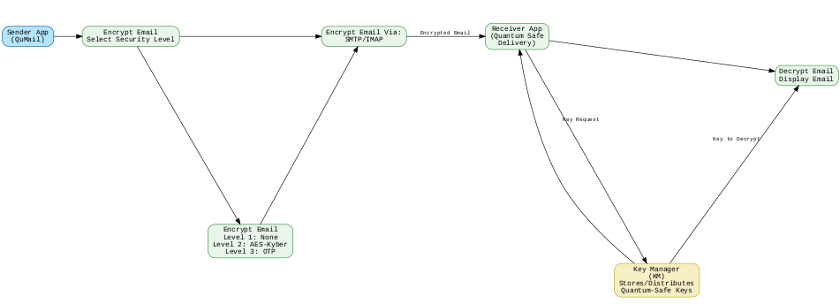
Basic Flow of the Project

Slide 10
Innovation / Novel Contributions
1. Hybrid QKD/KEM Architecture & Evaluation
Why is it valuable:
Right now, most PQC-secure email prototypes either use only post-quantum algorithms (Kyber, NTRU, etc.) or only QKD (Quantum Key Distribution) when they have physical access. Very few combine both — and certainly not in a user-friendly desktop app.
Novelty:
Allow the system to switch between real QKD keys (if available) and Kyber KEM fallback keys.
This builds a bridge between cutting-edge lab QKD setups and real-world users without such hardware.
2. Group Email Thread Encryption & Evaluation
Why is it valuable: Most end-to-end encrypted email systems encrypt per-message between two parties. Group email scenarios (project teams, committees) are still often handled insecurely, with messages being re-encrypted per recipient or downgraded to weaker schemes. Novelty: Enable a shared thread key that is PQC-secured and periodically rotated, so all group participants can read/write without exposing keys to outsiders. This makes encrypted group collaboration seamless and efficient while maintaining quantum-safe guarantees.

Slide 11
3. AI-Driven Automatic Encryption Level & TTL Selection & Evaluation
Why is it valuable: Users often don’t know which encryption level is best for a given email. Over-secure settings waste resources; under-secure settings risk compromise. Similarly, manual TTL (expiry) choices are often arbitrary. Novelty: Leverage a local AI model that analyzes:
Sensitivity of the email content (keywords, attachment type, recipient domain).
The AI then auto-selects the encryption level (No Encryption / PQC-AES / OTP) and recommends or sets a Time-to-Live. It brings intelligent security personalization that current email clients lack.
4. Device-Bound Decryption & Evaluation
Why is it valuable: If someone compromises the recipient’s email account (phishing, stolen credentials), they can normally download and read all messages from any device. Novelty: Tie decryption capability to a specific registered device using a combination of:
Device fingerprint (CPU ID, OS signature, cryptographic hardware token).
PQC key wrapping that only the registered device can unwrap.
Even if an attacker gets the ciphertext and credentials, they cannot decrypt unless they also have the original registered device.

Slide 12
5. (Optional) Self-Destructing / Expiring Emails & Evaluation
Why is it valuable: Many sensitive communications don’t need to live forever. Storing them increases attack surface. Current expiring email solutions (like Gmail Confidential Mode) aren’t PQC-protected and often still store plain text on the server until expiry. Novelty: Combine PQC + OTP encryption with a secure TTL enforcement mechanism at the client level — the ciphertext and decryption keys are deleted permanently after expiry, making recovery impossible even for the email owner.
6. (Optional) Do-Not-Forward / Screenshot Protection & Evaluation
Why is it valuable: Forwarding or screenshotting sensitive messages can spread information beyond intended recipients. While it’s impossible to absolutely prevent screenshots, current solutions do little more than watermark PDFs. Novelty:
Embed dynamic, per-recipient invisible watermarking (steganography in rendered text) to trace leaks.
Detect screenshot attempts using OS-level hooks in the desktop app and immediately blur/lock the content.
Disable copy-paste at the rendering layer for sensitive messages.

Slide 13
Github Link
Github Link
https://github.com/quantum-secure-email/quantum-secure-email-client-QMAIL

Slide 14
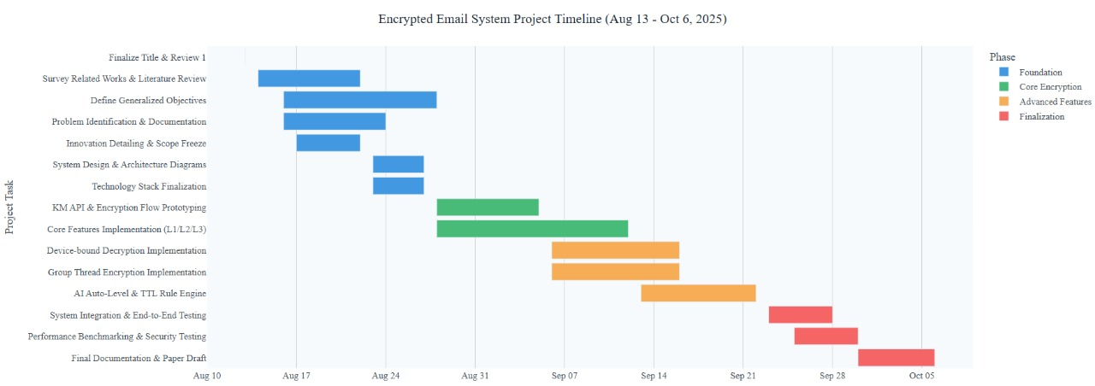
Timeline of the Project (Gantt Chart)

Slide 15
References (IEEE Paper format)
[1] C. H. Bennett and G. Brassard, “Quantum cryptography: Public key distribution and coin tossing,” Theoretical Computer Science, vol. 560, pp. 7–11, Dec. 2014 (original work published 1984). [2] National Institute of Standards and Technology (NIST), “Post-Quantum Cryptography Standardization,” 2023. [Online]. Available: https://csrc.nist.gov/projects/post-quantum-cryptography. [Accessed: Aug. 12, 2025]. [3] M. Mosca, “Cybersecurity in an era with quantum computers: Will we be ready?” IEEE Security & Privacy, vol. 16, no. 5, pp. 38–41, Sept.–Oct. 2018. [4] S. Pirandola, U. L. Andersen, L. Banchi, M. Berta, D. Bunandar, R. Colbeck, et al., “Advances in quantum cryptography,” Advances in Optics and Photonics, vol. 12, no. 4, pp. 1012–1236, Dec. 2020. [5] Proton Technologies AG, “ProtonMail Security Features.” [Online]. Available: https://proton.me/mail/security. [Accessed: Aug. 12, 2025]. [6] Open Quantum Safe Project, “liboqs – C library for quantum-safe cryptographic algorithms.” [Online]. Available: https://openquantumsafe.org/. [Accessed: Aug. 12, 2025]. [7] Google Cloud, “Gmail API Overview.” [Online]. Available: https://developers.google.com/gmail/api. [Accessed: Aug. 12, 2025].

Slide 16


